Slide 1

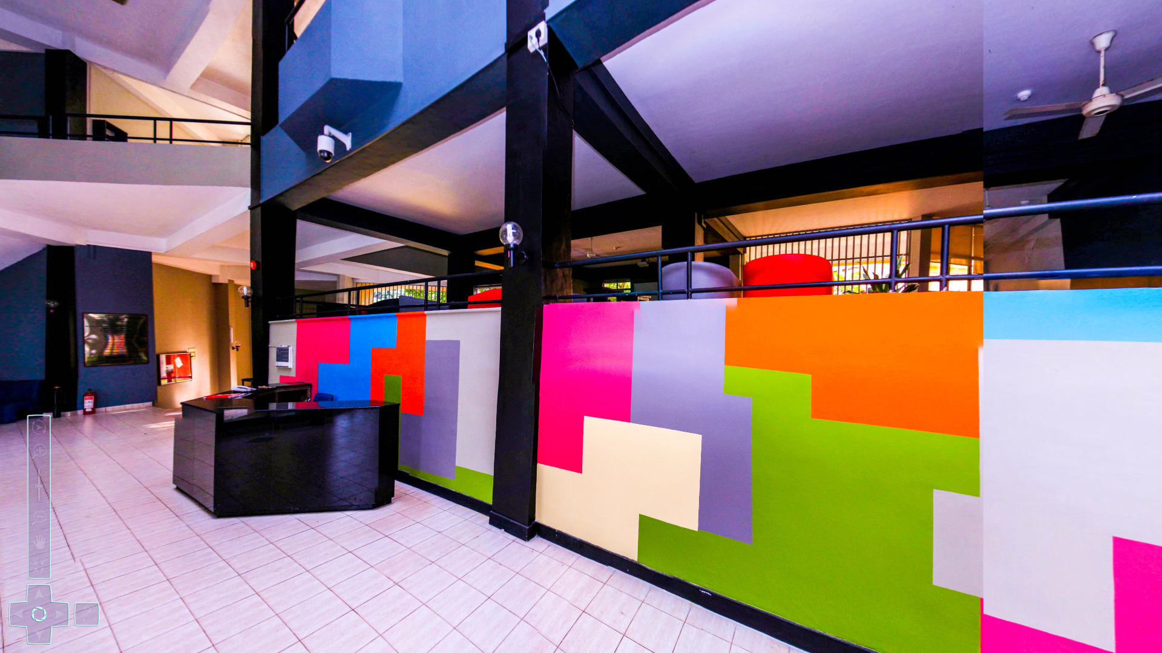
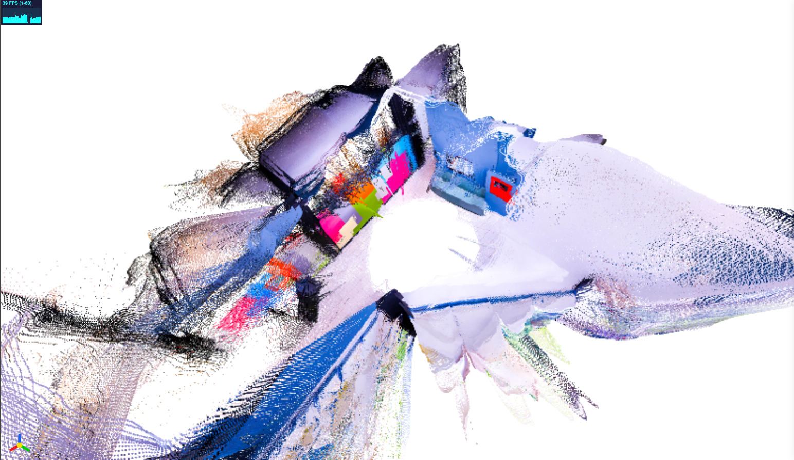
VGGT (Visual Geometry Grounded Transformer)
EN – 3160 Image Processing and Machine Vision
2 – Posers
Gunathilaka K.L – 220197E
Jayasekara S.P.R – 220257N

Slide 2
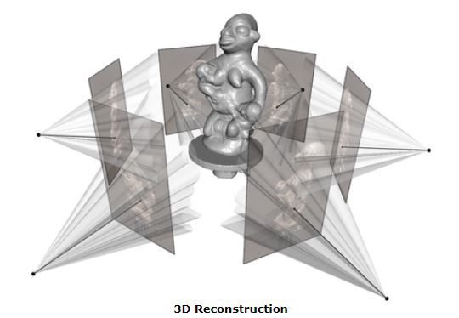
Problem
3D reconstruction is typically done with visual geometry methods such as Bundle Adjustment (BA) and SfM pipelines
These are slow and computationally expensive.
Examples :
VGGSfM
DUSt3R
MAS3TR
Related Work
Structure from Motion
Multi View Stereo
Tracking-Any-Point

Slide 3
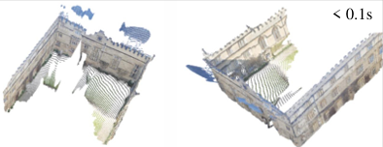
Proposed solution
Introducing VGGT - Visual Geometry Grounded Transformer
A feed forward neural network for 3D reconstruction
No iterative geometry optimization needed.
Can work with single/ multiple input.
Output Parameters :
Camera Intrinsics and Extrinsics
Point maps
Depth maps
3D point tracks

Slide 4

Model Architecture

Slide 5
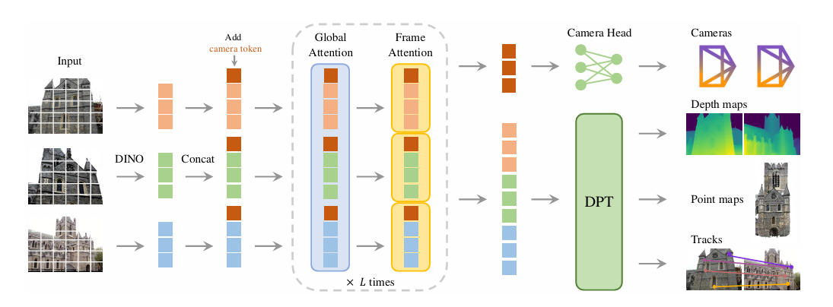
Architectural overview

Slide 6
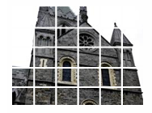
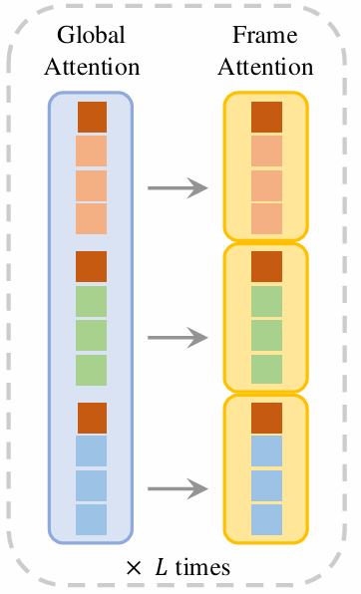
Tokenization
Images broken to tokens using DINO
Additional tokens – Camera + Register
Feature Backbone
24 Attention Layers.
Alternating self attention and global attention layers.
No cross-attention layers.

Slide 7

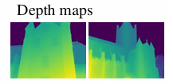
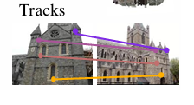
Prediction Heads
Camera Head
Dense Head
Tracking Head
Rotation Quarternion
Translation Vector
Field of View
Depth Map
Point Map
Tracking Features
Use tracking features to predict 2D correspondences for any query point across all frames

Slide 8
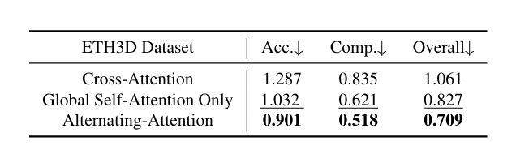
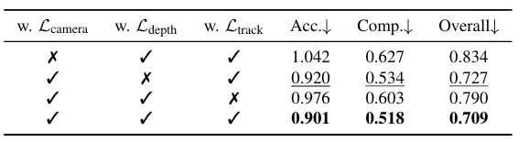
Ablation Studies
Feature Backbone
Multi-task Learning
Global self-attention only.
Cross-attention
Simultaneously learn all 3D parameters
Training only point map

Slide 9
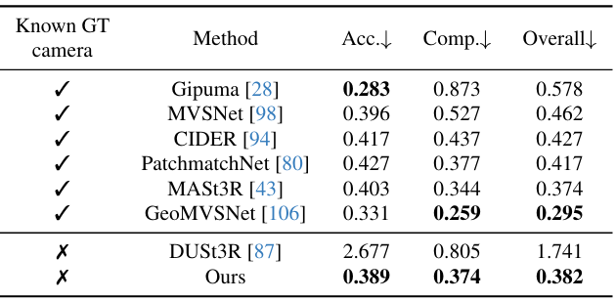
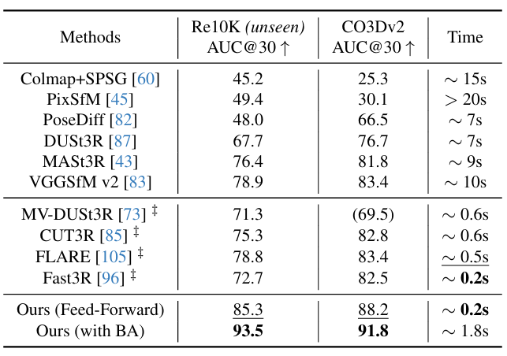
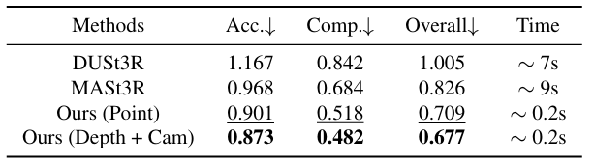
Results
Dense MVS Estimation
Camera Pose Estimation
Point Map Estimation

Slide 10
Novel Application

Slide 11
Application – Visual Transformer based Slam with Hybrid geometry Fusion
Input : Local video stream + IMU readings + Odometry (For ground based robots Encoders, Optical-Flow for aerial )
Model : VGGT (Run on central server)
Output : Live 3D RGB point-cloud + Estimated Pose
Strategy : Frames will be buffered during the inference time. Estimated camera pose fused with sensor readings → Precise Localization
Video
Frame Buffer
VGGT
Pose + Depth
Fusion
Map
Viewer
Block Diagram of the Process

Slide 12
Comparison with other 3d Mapping Approaches
Feature based
(ORB-SLAM, COLMAP)
SFM Based
Slow
Relatively Computationaly heavy
Streo SLAM/ RGB-SLAM
Expensive Hardware
Limited outdoor range / depth noise
LIDAR-SLAM
Expensive Hardware
Lack Colour Information

Slide 13

THANK YOU

